Slide 1
Regional Visit Logistics Innovation Limburg
Prof. dr. Niels Agatz, Scientific Director TKI Dinalog

Slide 2
oranje
donkerblauw
lichtblauw
100%
R 229
G 135
B 9
Hex E58709
R 4
G 58
B 86
Hex 043A56
R 29
G 142
B 202
Hex 1D8ECA
80%
R 234
G 159
B 58
Hex EA9F3A
R 54
G 97
B 120
Hex 366178
R 74
G 165
B 213
Hex 4AA5D5
60%
R 239
G 183
B 107
Hex EFB76B
R 104
G 137
B 154
Hex 68899A
R 119
G 187
B 223
Hex 77BBDF
40%
R 245
G 207
B 157
Hex F5CF9D
R 155
G 176
B 187
Hex 9BB0BB
R 165
G 210
B 234
Hex A5D2EA
20%
R 250
G 231
B 206
Hex FAE7CE
R 205
G 216
B 221
Hex CDD8DD
R 210
G 232
B 244
Hex D2E8F4

Slide 3
Who is LIOF?

Slide 4
Our stakeholders

Slide 5
Our mission
Working together, towards a more sustainable, smarter and healthier Limburg.
The world changes rapidly. We face many challenges and really need to change and adapt the way we move, produce and discard. We are sure that the companies in Limburg can provide solutions.
Our mission is to support entrepreneurs with our network financial solutions and much more within four transitions: energy, circularity, health and digitalization.

Slide 6
How we do this?

Slide 7
Startups, scale-ups and SME’s
that need support to innovate, invest, go international, or become sustainable, can count on LIOF.
New: Smart Energy Hub program and sustainable industrial areas. (PVB)

Slide 8
Energy Transition in Logistics
We strive towards an optimal use of renewable and efficient energysystems, towards green innovative company processes;
Energy efficiency: create new insights and support entrepreneurs to take action.
Mobility: sustainable and green transport.
Renewable energy: Solar-PV, Green-gas, Hydrogen, battery storage and E-charging
Exemplary role of LIOF: finance with impact, support what fits and helps our mission.

Slide 9
Goals of the Regional Visit
An initiative of Top Sector Logistics, TKI Dinalog and the Regional Economic Development Agencies
Learning about regional initiatives and challenges
Conversations about logistics of the future in the region
Finding ways to connect and help each other

Slide 10







Logistics Sector
Logistics service providers and suppliers

Slide 11
Added value of logistics
11%
Other characteristics
Innovative.
High international reputation.
Gateway to Europe.
Essential for food, health care, critical materials.
Contribution to the GDP
900k
Enabler for societal transitions and challenges, e.g.:
Circularity.
Energy transition.
Number of jobs
However, also negative externatlities, such as emissions, congestion, degradation of infrastructure, usage of space etc.

Slide 12






Top Sector Logistics - Program 2024-2027
Goals: Sustainable, resilient and resistant logistics
Cities and space
Supply chains
Multimodal freight transport
Mobile equipment & construction logistics

Slide 13
TKI Dinalog – Top Sector Logistics
TKI Dinalog provides direction and encourages joint knowledge development for the logistics of the Netherlands' future.
By:
Formulating research agenda
Initiating and organizing (co)financing for research and innovation programs
Sharing knowledge
Strengthening the knowledge ecosystem

Slide 14
Philosophy of Knowledge Agenda
Focus on challenges/technology not as goal
Based on practical societal challenges
Not restricted by actual funding = ambitious
Structured around general challenges that apply to different industries, sectors and field, e.g., distribution, retail, construction, health care, …
Both in – out (based on current “sector/supply chains”) and out-in (logistics as enabler)

Slide 15
National Knowledge Agenda Logistics
Analyses and interdisciplinary solutions
Technology | Business models | Behaviour | Policy | Ethics | Spatial planning

Slide 16
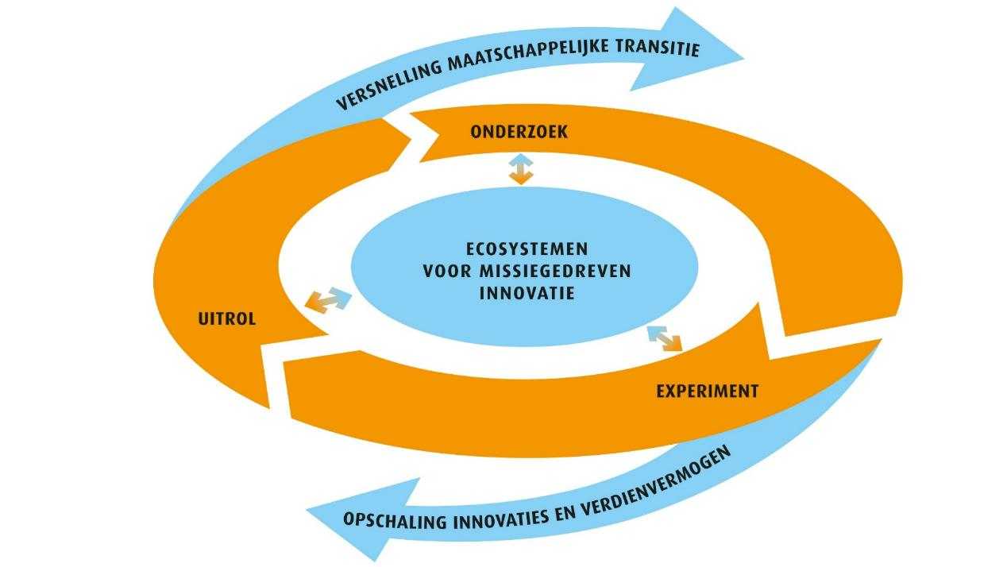
Public – private cooperation

Slide 17














New projects 2024 PPS (EA)
EnerLogiX – Integrated Energy and Logistics
Planning for Electric Trucking
HOPE – Human-centered OPtimization for supply chain Excellence
DigiTWOP – Multi-level Digital Twin based Warehouse Optimisation
RESPOND – Resilience Enhancement Strategies for Pharmaceuticals: Optimizing Differentiation

Slide 18














New project 2024 Construction Logistics (IandW)
BISON-KIT – Bouwlogistiek In Stedelijk Ontwikkeling – Kansen met dIgital Twins
EaSiCon – Efficiency and Sustainability in Construction
SYNERCIZE – SYnchromodal Transport NEtworks for a Construction Industry towards Zero Emissions

Slide 19
Planning Research Calls in 2025
PPP Innovation Scheme 2025 (EA)
  ~ €2,000,000 funding
  Opened since January 1, closes on March 28
Top Sector Logistics (IandW)
  € 3,500,000 funding
  Open in H1 2025
Top Sector Logistics - Mobile Equipment and Construction Logistics (IandW)
  € 1,800,000 funding
  Open in H1 2025

Slide 20
Social Earning Capacity and Broad Prosperity
short term innovation of supply chains
How can we positively improve and
Innovate the logistics system?
logistics as enabler
What is the role of logistics and the
Logistics sector in the future earning capacity of the Netherlands?

Slide 21
Circular Economy
short term innovation of supply chains
How to develop effective logistics
circular systems for
consumption and production?
logistics as enabler
How can logistics enable new circular production, distribution, and service models?

Slide 22
Energy Transition
short term innovation of supply chains
How can we reduce harmful emissions in supply chains
to zero?
logistics as enabler
How can logistics facilitate the energy transition?

Slide 23


Let’s stay connected
TKI Dinalog Newsletter
National Knowledge Agenda for Logistics

