Slide 1
Regional Visit Logistics Innovation Limburg
Prof. dr. Niels Agatz, Scientific Director TKI Dinalog

Slide 2
oranje
donkerblauw
lichtblauw
100%
R 229
G 135
B 9
Hex E58709
R 4
G 58
B 86
Hex 043A56
R 29
G 142
B 202
Hex 1D8ECA
80%
R 234
G 159
B 58
Hex EA9F3A
R 54
G 97
B 120
Hex 366178
R 74
G 165
B 213
Hex 4AA5D5
60%
R 239
G 183
B 107
Hex EFB76B
R 104
G 137
B 154
Hex 68899A
R 119
G 187
B 223
Hex 77BBDF
40%
R 245
G 207
B 157
Hex F5CF9D
R 155
G 176
B 187
Hex 9BB0BB
R 165
G 210
B 234
Hex A5D2EA
20%
R 250
G 231
B 206
Hex FAE7CE
R 205
G 216
B 221
Hex CDD8DD
R 210
G 232
B 244
Hex D2E8F4

Slide 3
Our stakeholders

Slide 4
Our mission
Working together, towards a more sustainable, smarter and healthier Limburg.
The world changes rapidly. We face many challenges and really need to change and adapt the way we move, produce and discard. We are sure that the companies in Limburg can provide solutions.
Our mission is to support entrepreneurs with our network financial solutions and much more within four transitions: energy, circularity, health and digitalization.

Slide 5
Energy Transition in Logistics
We strive towards an optimal use of renewable and efficient energysystems, towards green innovative company processes;
Energy efficiency: create new insights and support entrepreneurs to take action.
Mobility: sustainable and green transport.
Renewable energy: Solar-PV, Green-gas, Hydrogen, battery storage and E-charging
Exemplary role of LIOF: finance with impact, support what fits and helps our mission.

Slide 6







Logistics Sector
Logistics service providers and suppliers

Slide 7
TKI Dinalog – Top Sector Logistics
TKI Dinalog provides direction and encourages joint knowledge development for the logistics of the Netherlands' future.
By:
Formulating research agenda
Initiating and organizing (co)financing for research and innovation programs
Sharing knowledge
Strengthening the knowledge ecosystem

Slide 8
National Knowledge Agenda Logistics
Analyses and interdisciplinary solutions
Technology | Business models | Behaviour | Policy | Ethics | Spatial planning

Slide 9














New projects 2024 PPS (EA)
EnerLogiX – Integrated Energy and Logistics
Planning for Electric Trucking
HOPE – Human-centered OPtimization for supply chain Excellence
DigiTWOP – Multi-level Digital Twin based Warehouse Optimisation
RESPOND – Resilience Enhancement Strategies for Pharmaceuticals: Optimizing Differentiation

Slide 10














New projects 2024 Construction Logistics (IandW)
BISON-KIT – Bouwlogistiek In Stedelijk Ontwikkeling – Kansen met dIgital Twins
EaSiCon – Efficiency and Sustainability in Construction
SYNERCIZE – SYnchromodal Transport NEtworks for a Construction Industry towards Zero Emissions

Slide 11
Planning Research Calls in 2025
PPP Innovation Scheme 2025 (EA)
  ~ €2,000,000 funding
  Opened since January 1, closes on March 28
Top Sector Logistics (IandW)
  € 3,500,000 funding
  Open in H1 2025
Top Sector Logistics - Mobile Equipment and Construction Logistics (IandW)
  € 1,800,000 funding
  Open in H1 2025

Slide 12
Energy Transition
short term innovation of supply chains
How can we reduce harmful emissions in supply chains
to zero?
logistics as enabler
How can logistics facilitate the energy transition?

Slide 13

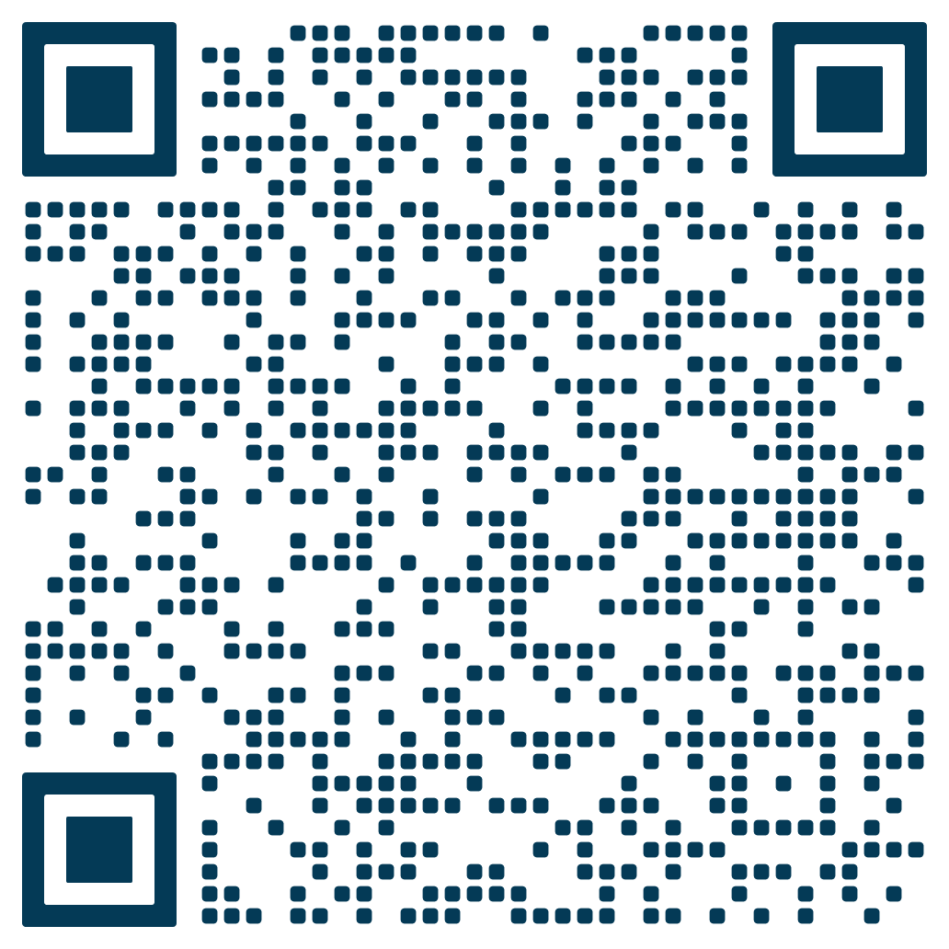
Let’s stay connected
TKI Dinalog Newsletter
National Knowledge Agenda for Logistics

