Slide 2
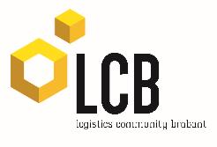
Prof. dr. Albert Veenstra
Wetenschappelijk directeur TKI Dinalog

Slide 3
Games for the better… Transportation and Logistics Dr. Heide K. Lukosch Delft University of Technology

Slide 4
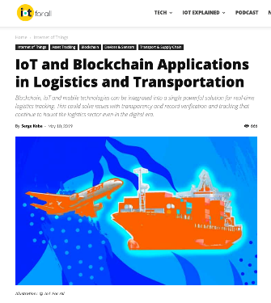
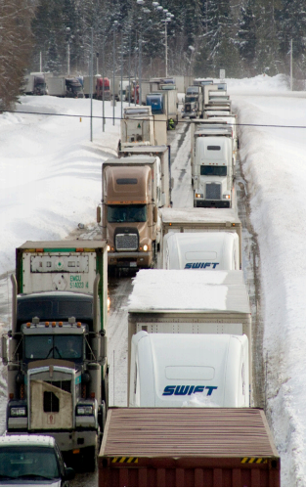
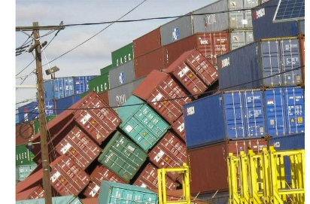
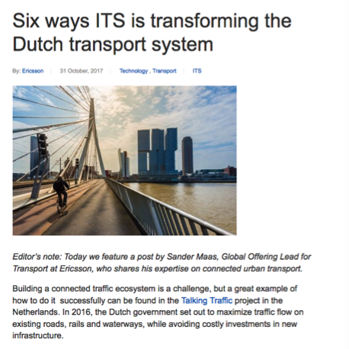
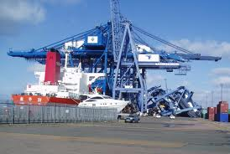
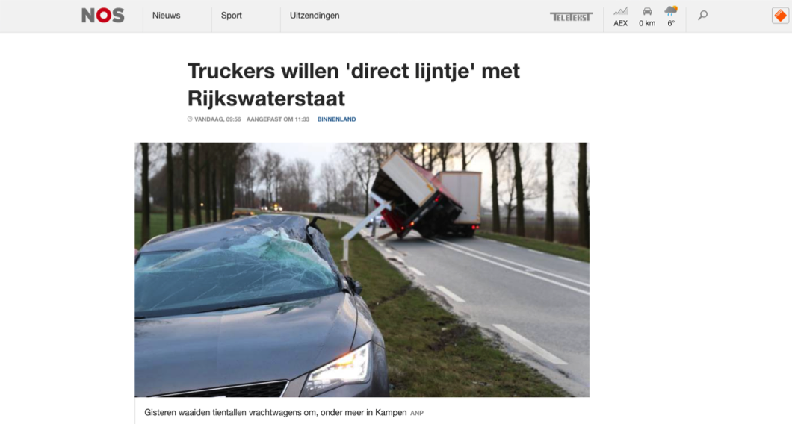
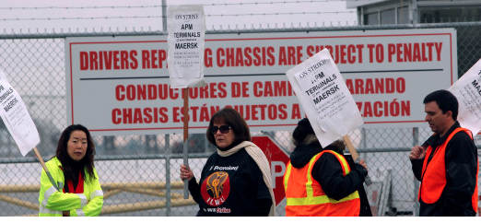

Slide 5
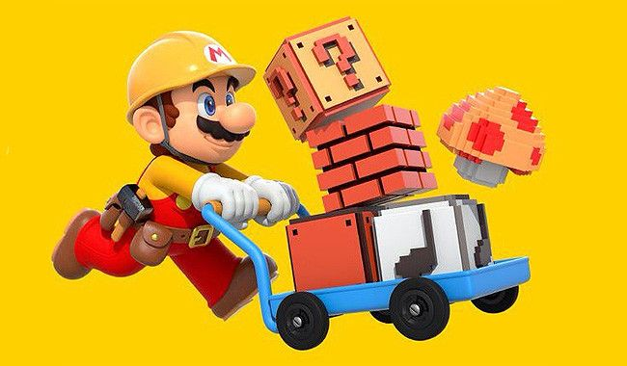
© Nintendo

Slide 6
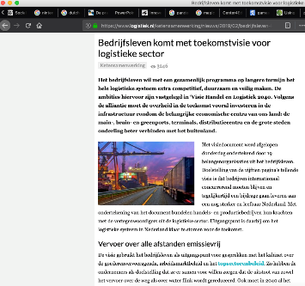
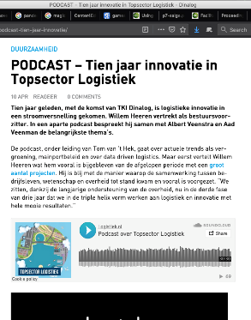
Transport and Logistics
Characteristics of the domain
Immense growth
Horizontal and vertical collaborations
Uncertain Future Developments
Main challenges
Highly competitive domain
Barriers for communication and information sharing
Need for technical and social innovation
© EBPI
Meier & Schumann, 2007; Mačiulis, Vasiliauskas, & Jakubauskas, 2009; UN, 2011; Kurapati et al, 2014; Lukosch et al., 2016; Dinalog; Logistiek

Slide 7
Serious Games
Games can support decision-making in a complex and uncertain system
Physical games help participants to collaboratively design a system
Digital games improve awareness for aspects of complexity
Development and testing of new policies and models
Rail Cargo Challenge Amsterdam, SynchroGaming project

Slide 8
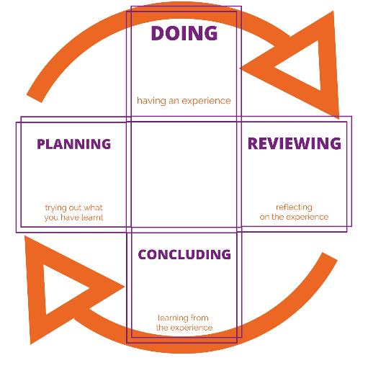
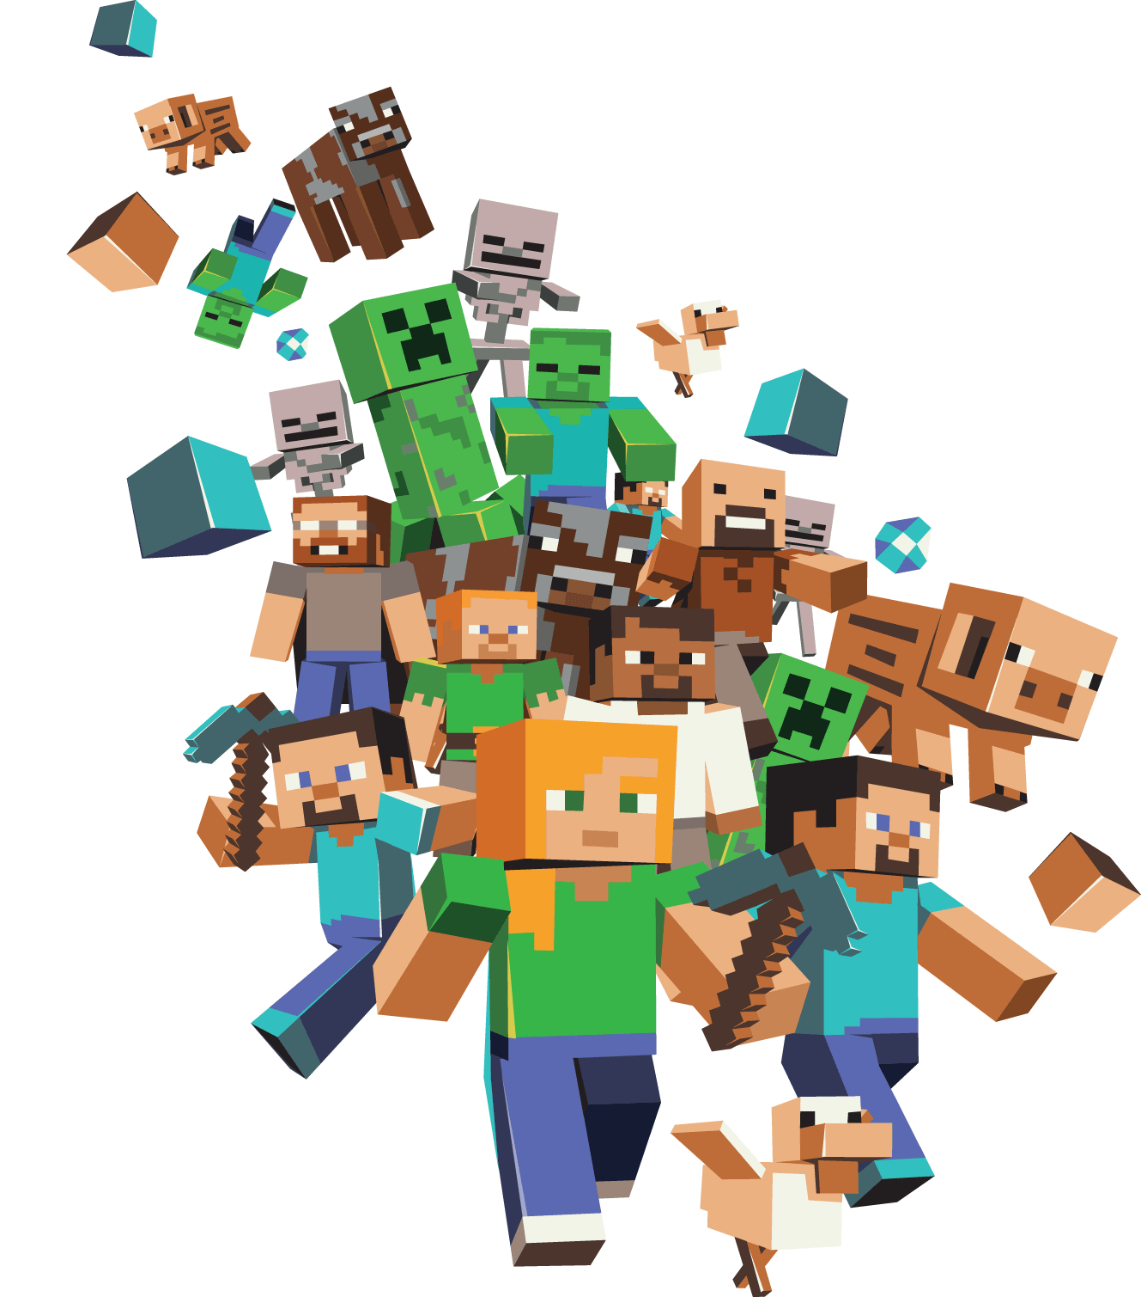
Games for Learning
Experiential Learning
Social Activity
Realism
Safe Environment
Kolb, 1984
© Minecraft

Slide 9
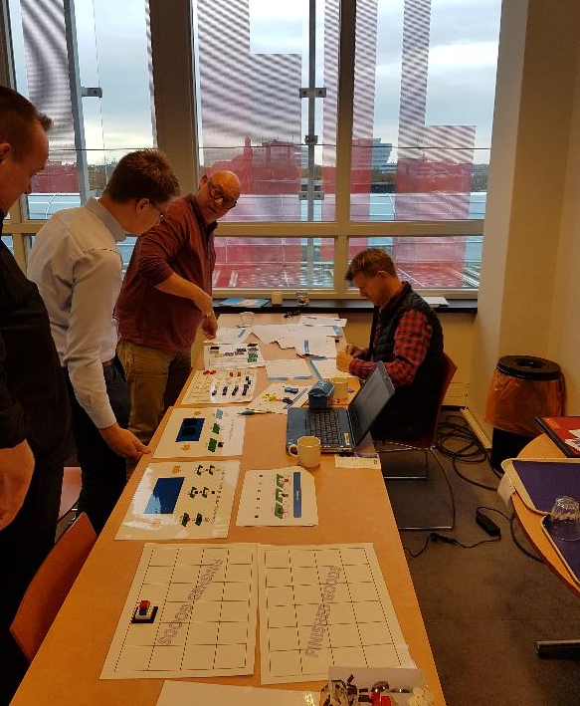
BLOKKO
Get to know Sales and Operations Planning
Team Competition
Hybrid Game: Board and digital tool
Application in secondary education (MBO4-HBO basis)

Slide 10
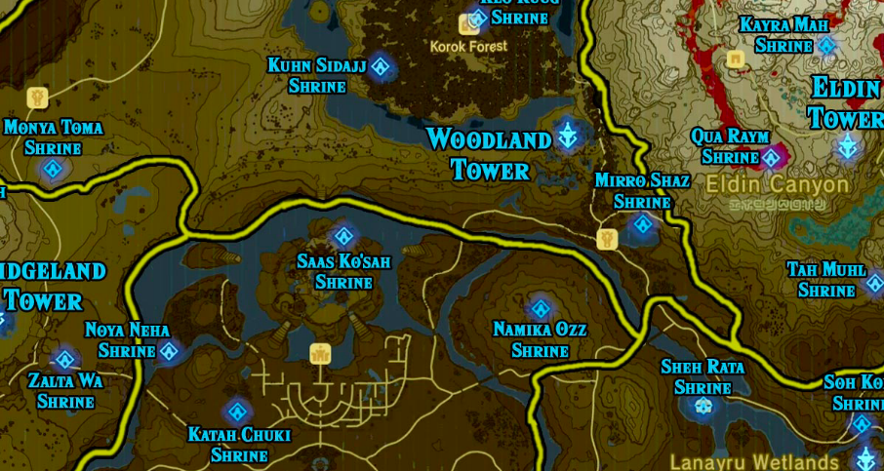
Games to create Awareness
Perception
Comprehension
Prediction
Increased performance
© Nintendo

Slide 11
Innoveren kun je leren
Become aware of Innovation and different perspectives
Collaboration!
Role-playing game
Application in organizations dealing with innovations

Slide 12
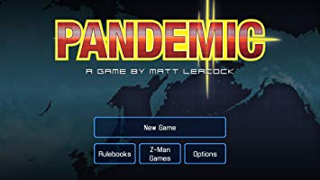
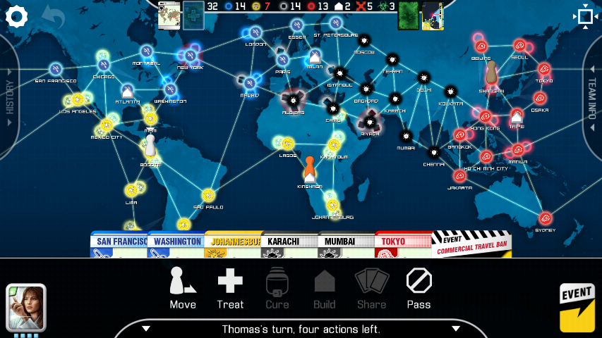
Games for Future Measures
Collaborative Learning
Deep Insights
Systems Design
Ex-ante evaluation
© Asmodee Digital

Slide 13
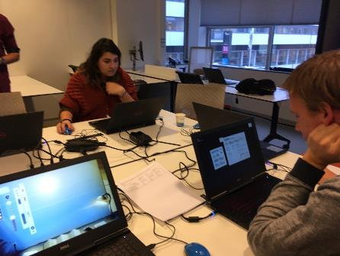
MasterShipper
Develop strategies towards synchromodal transportation
Experiment and learn
Digital single-player game
Application in transport organizations, secondary and higher education
MasterShipper, SynchroGaming project

Slide 14
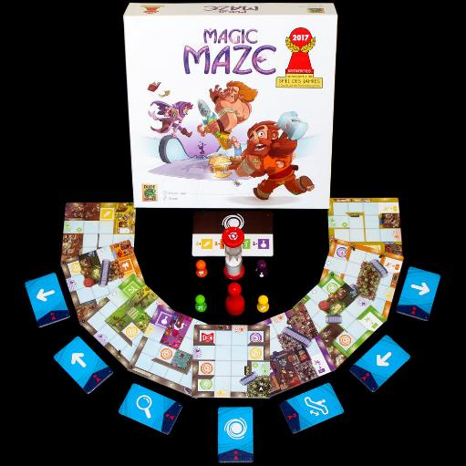
Games for (better) Collaboration
Social Play
Cross-competencies
Scenario-based
Participatory Design
© Pegasus Spiele

Slide 15
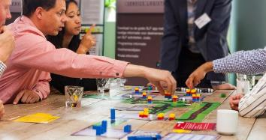
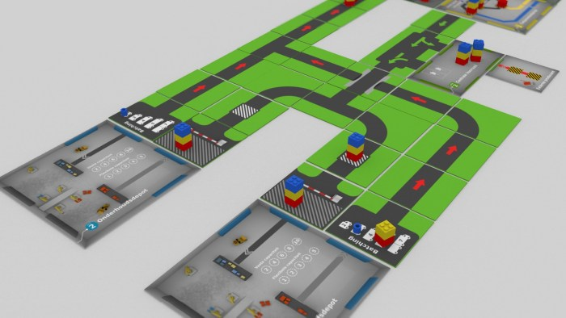
Service Supply Chain Game
Learn about the role of collaboration and innovation
Collaborate!
Board game
Application in supply chain organizations, secondary and higher education

Slide 16
Games for Teams
Roles
Organizations
Skills
Adaptation and Growth
New Zealand All Blacks Haka

Slide 17
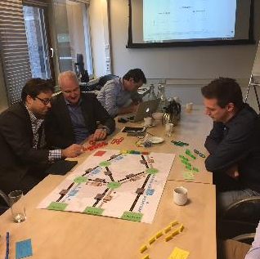
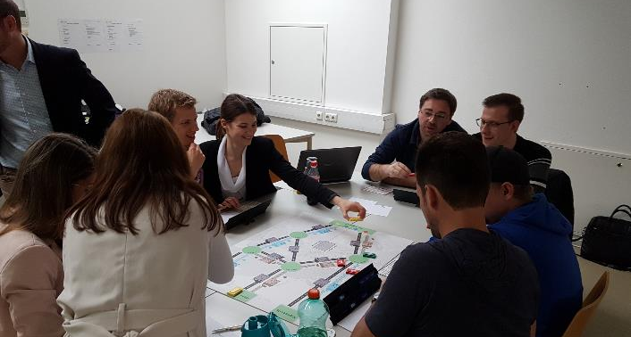
You’ve got freight!
Learn about the role of information sharing and collaboration
Communicate?
Board game with digital support
Application in transport organizations and higher education

Slide 18
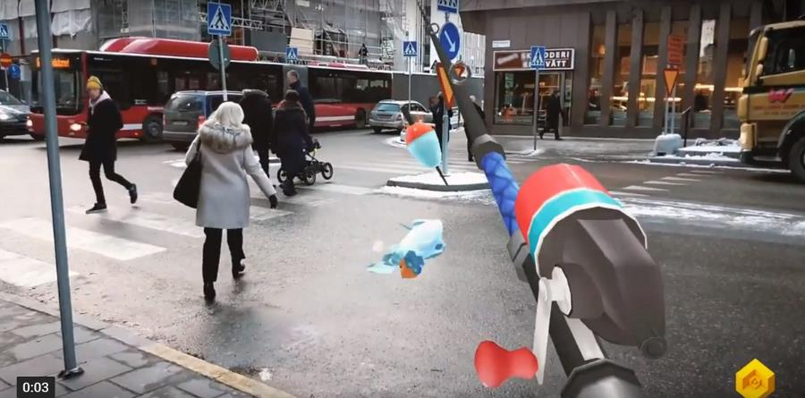
Games as Valorisation tool
Outcomes
Debriefing
Transfer
Impact
© Resolution Games

Slide 19
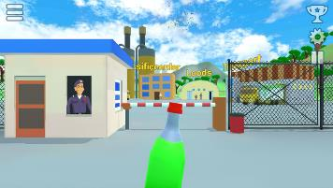
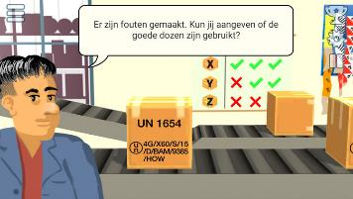
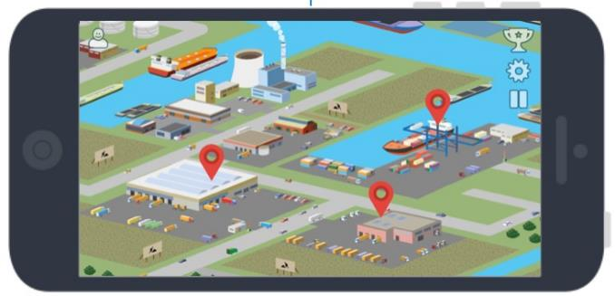
Rondje Logistiek
Attract workforce
Engage!
Flexible digital app
Application in transport organizations and (higher) education

Slide 20
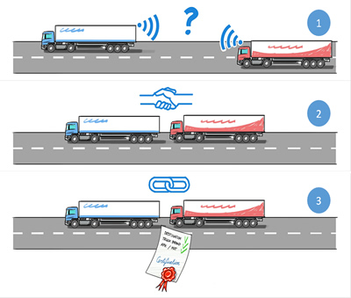
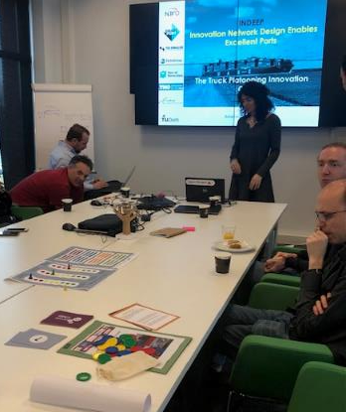
Games for the better… Transportation & Logistics
Serious Games
As process and product can contribute to future-ready transportation and logistics systems
Interactive, engaging tools to support
Learning and Training
Decision Making
Collaboration
Valorisation
New ways of decision support with immediate interaction and data processing
© Concept of Truck Platooning, IPI Singapore
Mobinn Game, Indeep Project

Slide 22
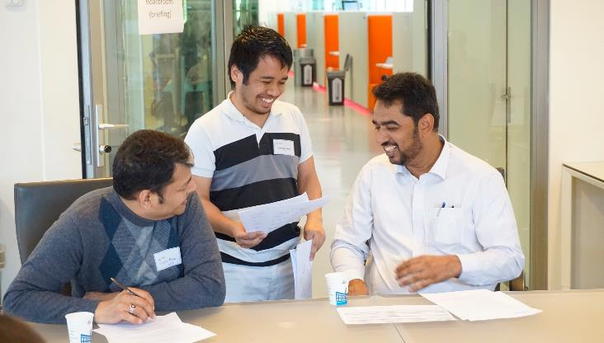
“The exercise perfectly simulated the human side. Our work is all about paperwork and relationships. We think it’s all digital, but the human side is much more important!”
Logistics aid worker at iTRACK exercise 2018

